Slide 1


Warsztaty Code & Cloud z Unit4
Piotr Rogala

Slide 2


About Me
Current working in UNIT4
MVP Azure
Blog: justcloud.pl
FB Page: facebook.com/justcloudpl
Group leader:
Microsoft Azure User Group Poland

Slide 3
piotr@justcloud.pl

Slide 4

Wrocławska Grupa Microsoft Azure User Group Poland
https://www.meetup.com/Microsoft-Azure-Users-Group-Poland
https://www.facebook.com/groups/azureugpl

Slide 5






Grupy we Wro
CloudPoland
http://slack.justcloud.pl
DevOps Wrocław
https://www.meetup.com/Wroclaw-DevOps-Meetup
PPOSH
https://www.meetup.com/Polish-PowerShell-Group-PPoSh
Wrocław .NET User Group
https://www.meetup.com/wrocnet
MAUGP
http://azureug.org
SysOps Polska
https://www.meetup.com/SysOpsPolska

Slide 6
Prezentacja
https://unit4.justcloud.pl

Slide 7
Agenda
Azure Manage
Azure Resource Manager
JSON’s
WorkShop

Slide 8




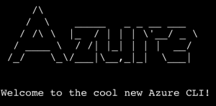
Azure Manage
Portal WEB
Visual Studio
Visual Studio Code
VSTS
PowerShell
CLI (cross-platform)

Slide 9
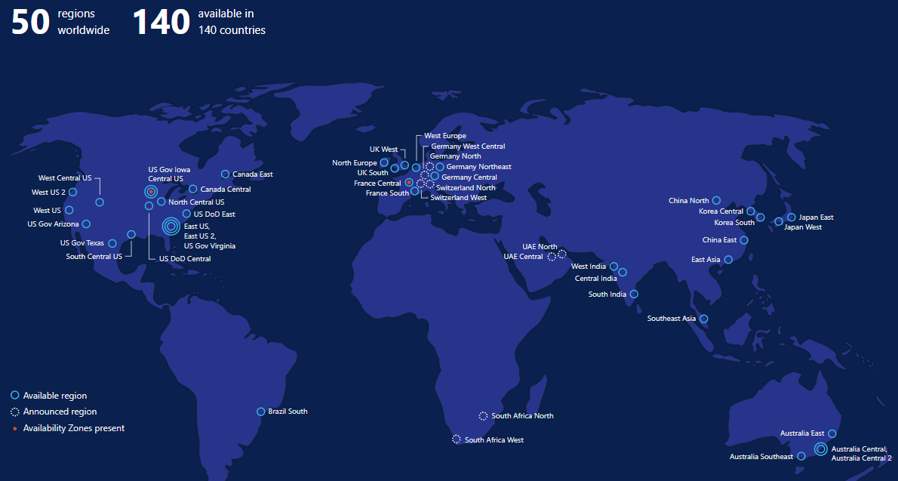
http://map.buildazure.com/

Slide 10
Downtime, Outages and Failures
Current status
https://azure.microsoft.com/en-us/status/#current
Status history
https://azure.microsoft.com/en-us/status/#history

Slide 11
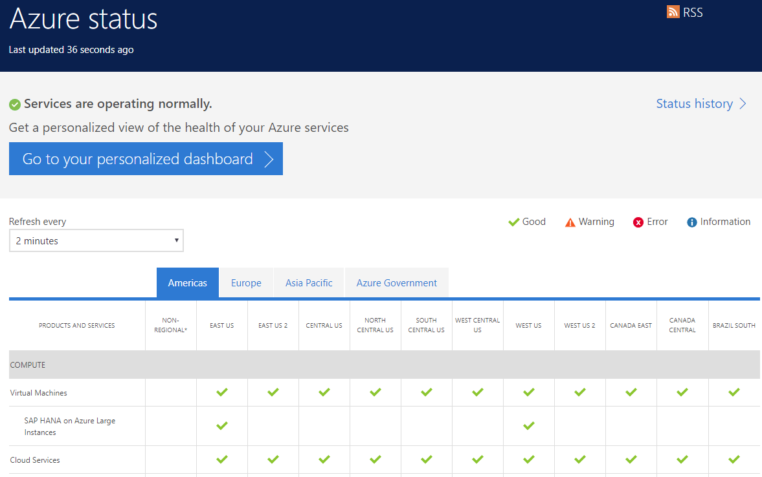

Slide 12

Automation – Deploy .json
Prosta budowa skryptów do tworzenia zasobów w RG
Automatyzacja tworzenia środowisk
Uniwersalne rozwiązanie

Slide 13


Slide 14
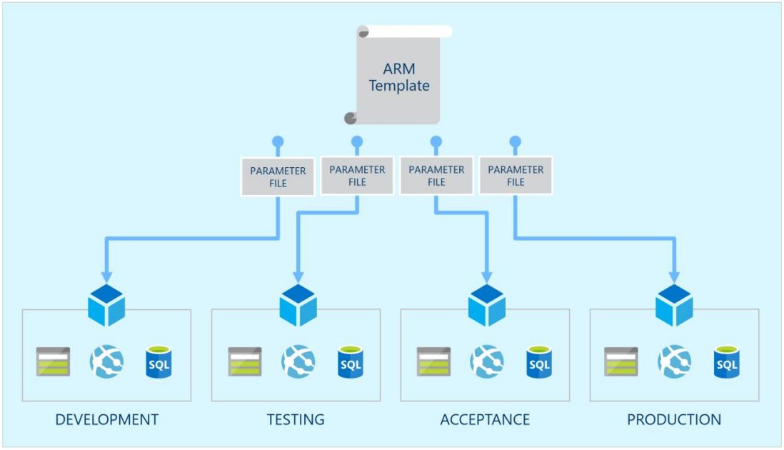

Slide 15
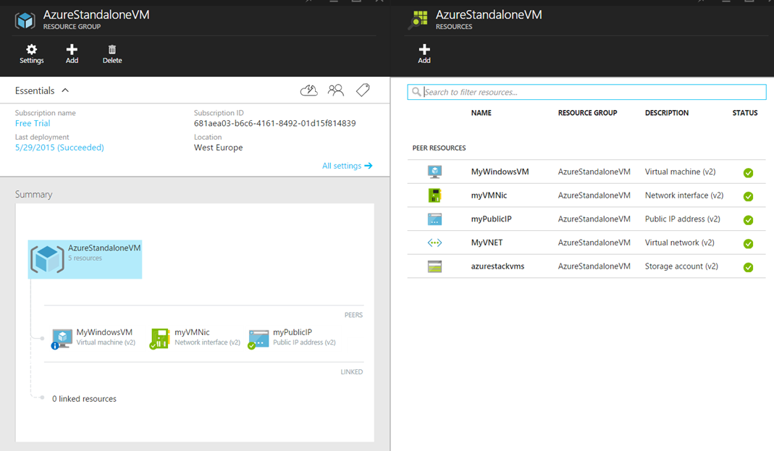
Azure Resource Group

Slide 16
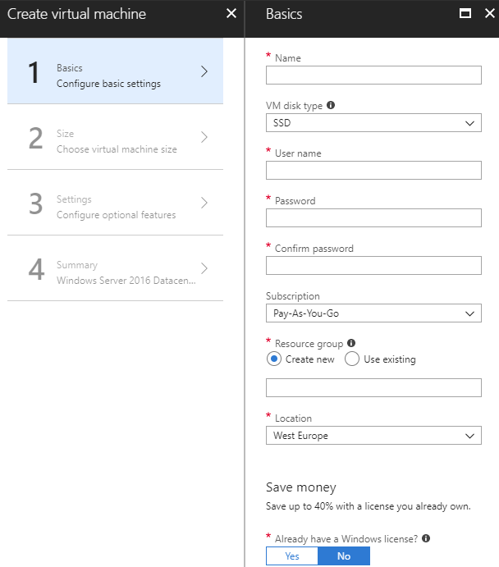

Slide 17
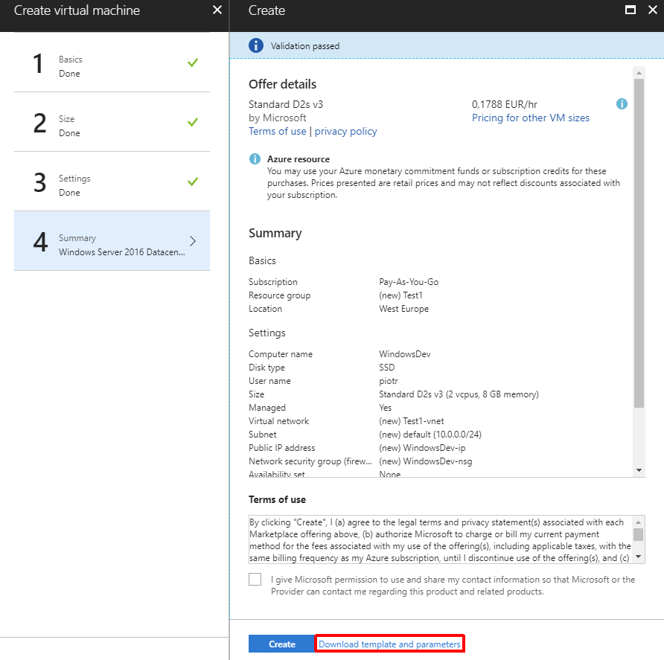

Slide 18
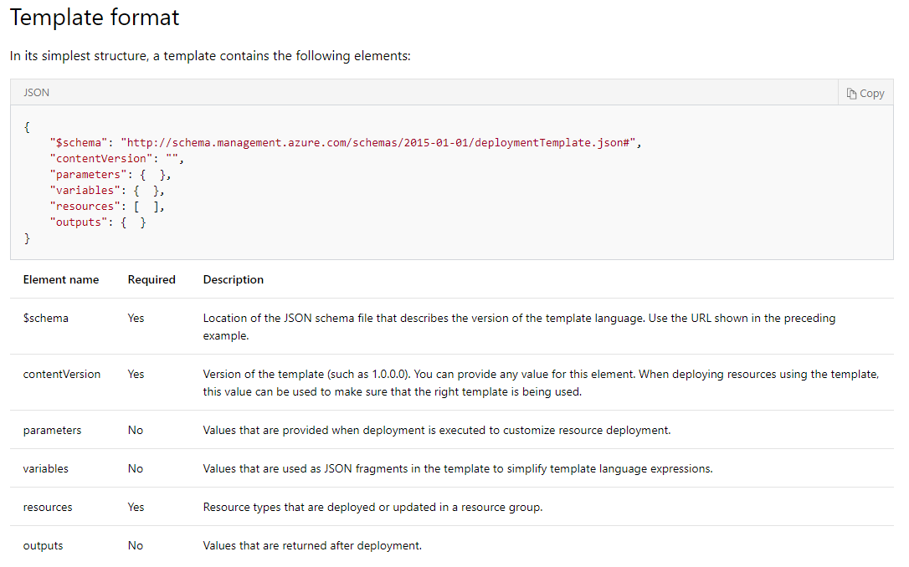
https://docs.microsoft.com/en-us/azure/azure-resource-manager/resource-group-authoring-templates

Slide 19
Gotowe szablony - .json
https://github.com/Azure/azure-quickstart-templates
https://github.com/RogalaPiotr/JustCloudPublic

Slide 20
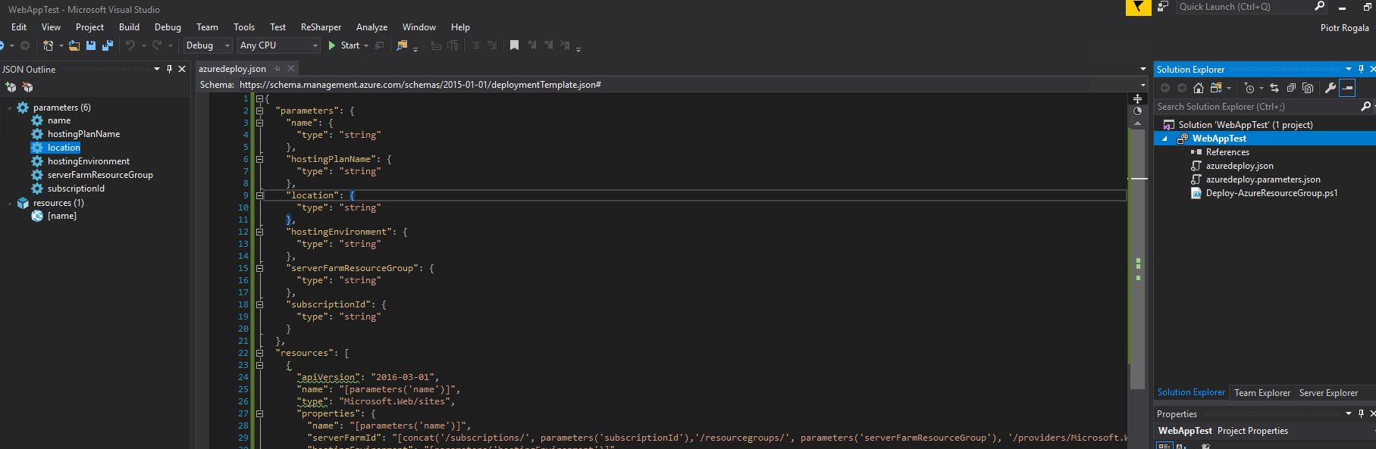

Slide 21


Slide 22
#1
Create Web App via Portal
Create Web App via Portal – download automation script
Deploy Web App from script via Visual Studio
Notes:
https://docs.microsoft.com/en-us/azure/azure-resource-manager/resource-group-using-tags

Slide 23
#2
https://github.com/RogalaPiotr/JustCloudPublic/tree/master/simple-web-app-deployment
Dowonload json
Copy/Paste to project in VS
Deploy

Slide 24
#3
Open VSTS project
i.e. https://justcloud.visualstudio.com/JustCloud/_build
Sync json to repo on VSTS
Create build
Configure CI
Create deployment to Azure
Configure Variables
Deploy

Slide 25

Podobała Ci się prezentacja? Napisz do mnie!
Questions?
piotr@justcloud.pl

Slide 26
